Slide 1

Docker Advanced (Day 1)

Slide 2
Session Overview
01. Introduction to Docker Security Concepts
06. Hands-On Lab Session
02. Best Practices for Secure Docker Images
05. Docker Isolation Techniques
03. Image signing and trusted repositories
04. Least Privilege Principles

Slide 3
Container Recap..
Part-00
Container Technology Fundamentals

Slide 4
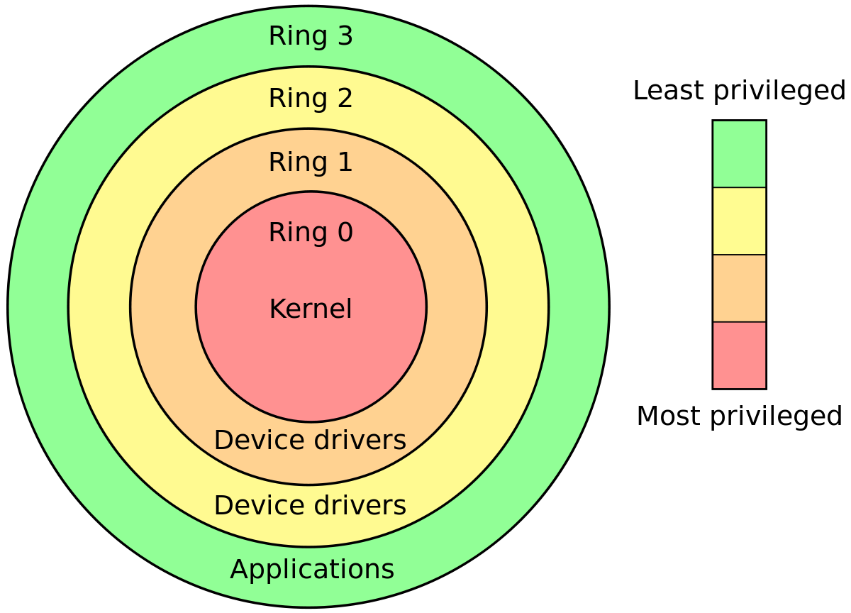
Linux User space & kernel space

Slide 5
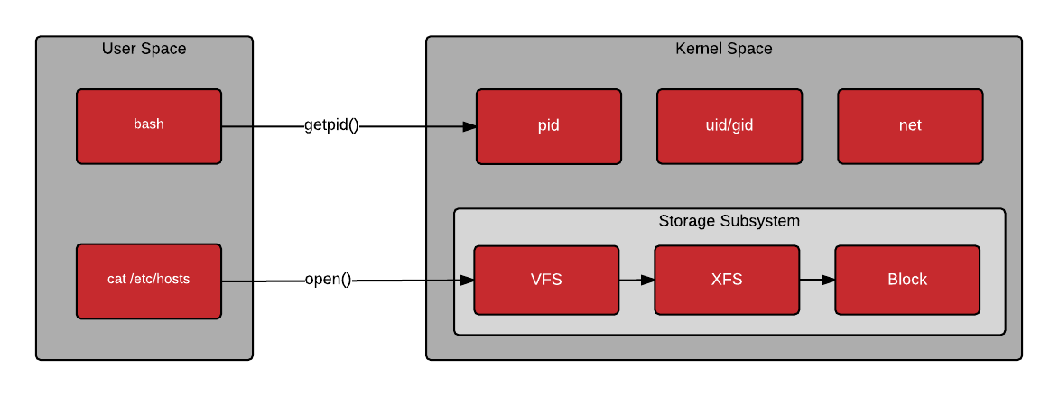
Linux User space & kernel space communication

Slide 6
Container (Docker) Architecture
What is a container?
A container is not a lightweight VM — it is just a process (or group of processes) running with isolation enforced by the Linux kernel using:
- Namespaces
- cgroups
- Union File Systems
Containers share the host kernel, unlike virtual machines, which emulate hardware.

Slide 7


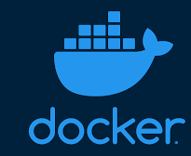
Docker Architecture Summary
Main Components:
Container:
Actual running process
isolated by
namespaces/cgroups
Docker CLI
Docker CLI:
Frontend interface for
users
Docker Daemon
(dockerd + containerd)
runc
(OCI runtime)
Docker Engine:
Docker daemon (dockerd):
Manages images,
containers
Container runtime:
(default: runc)
Linux Kernel
-Namespace
-Cgroups
-Overlay
Containerized Process

Slide 8
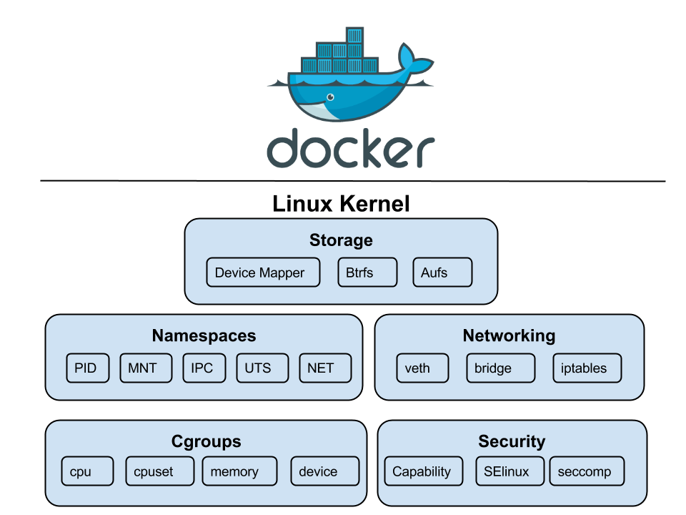
Docker architecture - different View

Slide 9
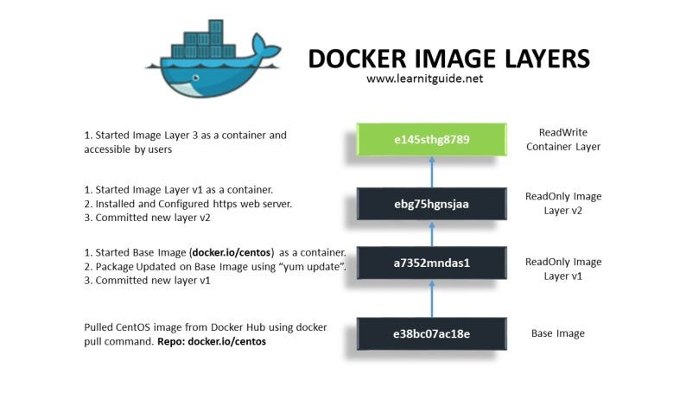
Docker Aufs – Layered view

Slide 10
Core Building Blocks of Container Isolation
Namespaces
Control Groups (cgroups)
isolate what a process can see.
limits what resources it can use.
- Examples:
Namespace | Isolates
pid | Process IDs (each container has PID 1)
mnt | Filesystems and mount points
net | Network interfaces and stacks
ipc | Interprocess communication
uts | Hostname and domain
user | User and group IDs
cgroup | (not isolation, but grouping mechanism)
Limit memory: memory.max = 256MB
CPU shares: cpu.shares = 1024
Block device throttling
- Docker automatically sets these limits per container using the
--memory, --cpus, etc., ﬂags.
Union Filesystems (OverlayFS)
- Docker images use layered ﬁlesystems so that:
- Common base layers (e.g. Ubuntu) are shared
- Only changes are stored in top read-write layer
- Eﬃcient storage + fast deploys.

Slide 11
Docker Security Best Practices
Part-01
Introduction to container security fundamentals

Slide 12
Why Do Containers Need Dedicated Security?
01
02
03
Containers are Just process
Default Docker Behavior Isn't Always Secure
Containers Multiply Risk Quickly
Containers are Just process.
Default Docker Behavior Isn't Always Secure.
Containers Multiply Risk Quickly.

Slide 13
Common Container Attack Surfaces
Image Layer
Host Layer
- Outdated base images (e.g., old Ubuntu with known CVEs)
- Embedded secrets in Dockerfiles
- Unscanned third- party layers
- Shared kernel with containers → one exploit affects all
- Poor isolation boundaries
- Kernel module or syscall abuse
01
02
03
Runtime Layer
- Containers running as root
- Privileged containers (- -privileged)
- Volume mounts from host (e.g., - v /:/host)

Slide 14
Questions
Why is Alpine preferred over Ubuntu for secure builds?
What’s the danger of --privileged containers?
Can we trust all Docker Hub images? Why or why not?

Slide 15
Questions & Answers
Why is Alpine preferred over Ubuntu for secure builds?
Smaller, fewer packages → lower attack surface
What’s the danger of --privileged containers?
Full access to host devices, possible escape via kernel interfaces
Can we trust all Docker Hub images? Why or why not?
No — some are unverified or outdated, always scan before use

Slide 16
Docker Security Best Practices
Part-02
Best practices for securing Docker containers

Slide 17
Start Secure — During Image Build
DOs:
DON’Ts:
Use minimal base images (e.g., alpine, distroless)
Use multi- stage builds to avoid keeping build tools in final image
Clean up cache and package manager metadata
Don't use latest tag blindly — it's mutable and unpredictable
Don't embed secrets or credentials in Dockerfile
Don't install unnecessary packages or debugging tools

Slide 18
Run Secure — During Container Execution
Principles:
Never run as root inside the container (use USER directive)
Use read- only filesystems (- -read- only)
Drop unneeded Linux capabilities (- -cap- drop=ALL, then add only required ones)
Example runtime command:
docker run - -user nobody - -read- only - -cap- drop=ALL myimage

Slide 19
Use Trusted Registries & Verified Images
Best Practices:
- Enable Docker Content Trust (DCT) for image signing
- Pull only from private or signed registries
- Use SBOMs (Software Bill of Materials) for transparency
- Automate CVSS scoring and policy enforcement
Command to enable Docker Content Trust:
export DOCKER_CONTENT_TRUST=1

Slide 20
Manage Secrets Properly
Principles:
Preferred runtime secret injection via:
- Never bake secrets into the image
- Use Docker secrets (if using Docker Swarm) or volume- mounted secrets
- Environment variables (last resort)
- External secret managers (e.g., Vault, AWS Secrets Manager)

Slide 21
Additional Recommendations
Resource limits:
Audit logs:
Scan on CI/CD:
Security Benchmarks:
Use - -memory, - -cpu- shares, - -pids- limit to restrict container abuse
Enable Docker daemon auditing and centralized log shipping
Integrate Trivy, Grype, or Docker Scout in your pipelines
Refer to CIS Docker Benchmark and test with docker- bench- security

Slide 22
Questions
What is the risk of using the latest tag in production?
Why is using root inside containers discouraged?
Name one way to verify container image integrity.

Slide 23
Questions & Answers
What is the risk of using the latest tag in production?
Images can change without notice; breaks reproducibility and security consistency.
Why is using root inside containers discouraged?
A compromised container can become a root process on the host if not properly isolated
Name one way to verify container image integrity.
Docker Content Trust, Cosign signatures, hash comparison

Slide 24
Docker Security Best Practices
Part-03
Image signing and trusted repositories

Slide 25
Why Image Trust Matters
Docker images can be tampered with, especially when pulled from public registries.
Without verification, you're blindly trusting code from unknown sources.
Supply chain attacks increasingly target container registries and CI/CD pipelines.

Slide 26
What Is Image Signing?
Signing =
Ensures:
Analogy:
cryptographically proving authenticity and integrity of an image.
The image is from a trusted source
The image hasn’t been modified after signing
Think of it like GPG/SSL for Docker images.

Slide 27
Image Signing Tools
01.
02.
03.
Docker Content Trust (DCT)
Cosign (Sigstore)
Notary v2 / ORAS
Purpose:
Enables image signing using Notary v1
Note:
Simple to use, deprecated
by Docker
Purpose:
Modern, keyless signing
Note:
Integrates with GitHub, KMS, etc.
Purpose:
OCI native artifact signing
Note:
Still evolving standard

Slide 28
Example – Sign with Cosign
Prerequisites
Install Cosign:
cosign generate-key-pair
Signing:
cosign sign - -key cosign.key myregistry/myimage:tag
Verification:
cosign verify - -key cosign.pub myregistry/myimage:tag
Note:
You can use OIDC (e.g., GitHub Actions) to do keyless signing too.

Slide 29
Best Practices for Registries
Principles:
Use private registries (e.g., Harbor, AWS ECR, GCR)
Enable automated image scanning in registries
Restrict pull access only to signed/trusted images
Use admission control in CI/CD to block unsigned images

Slide 30
Questions
Why should you avoid pulling images directly from Docker Hub in production?
、
Which tools allow image signing and verification?
Can image signatures prevent runtime exploits?

Slide 31
Questions & Answers
Why should you avoid pulling images directly from Docker Hub in production?
Trust issues, outdated, unsigned, and can be tampered
、
Which tools allow image signing and verification?
Cosign, Docker Content Trust, Notary v2
Can image signatures prevent runtime exploits?
No — they ensure trust at pull/build time, not runtime behavior.

Slide 32
Least Privilege Containers
Part-04
Understanding the least privilege principle in Docker

Slide 33
What is the Principle of Least Privilege?
Deﬁnition:
A process should have only the minimum privileges necessary to
perform its function.
Why it matters in containers:
- Containers often default to full Linux capabilities and root access.
- Privilege escalation within a container can compromise the host.
Note:
Enforcing it helps reduce attack impact and detection surface.

Slide 34
Avoid Running as Root
Running containers as root is dangerous because:
Use the USER instruction in your Dockerfile:
Example runtime command:
- If compromised, attacker gets host root privileges if namespaces aren’t
strict.
- Most containers don’t need root at all.
Dockerfile example:
FROM alpine
RUN adduser -D myuser
USER myuser
docker run - -user 1001:1001 myapp

Slide 35
Drop Unnecessary Capabilities
!!
$
Linux capabilities are like fine- grained root powers.
Example runtime command:
- Containers inherit dozens of capabilities by default.
- You should drop all and add only those explicitly required.
docker run - -cap- drop=ALL - -cap- add=NET_BIND_SERVICE myapp

Slide 36
Filesystem Security Options
Read-only root filesystem:
No privilege escalation:
Example runtime flags:
Prevent tampering with container internals.
Prevent setuid programs from becoming root.
docker run \
--read-only \
--tmpfs /tmp \
--security-opt no-new-privileges:true \
myapp

Slide 37
Dockerﬁle Hardening Summary
Action | Dockerfile / Args
Use non-root user | USER appuser
Drop capabilities | --cap-drop=ALL
No privilege escalation | --security-opt no-new-privileges:true
Read-only ﬁlesystem | --read-only, --tmpfs /tmp

Slide 38
Questions
What can happen if you run containers as root?
01
Why should we avoid granting default Linux capabilities to containers?
02
How can you make the root filesystem immutable in a container?
03

Slide 39
Questions & Answers
What can happen if you run containers as root?
01
Attackers can exploit the kernel or mounted volumes to escape.
Why should we avoid granting default Linux capabilities to containers?
02
Many are rarely needed and can be abused for escalation.
How can you make the root filesystem immutable in a container?
03
Use - -read- only and - -tmpfs

Slide 40
Least Privilege Containers
Part-05
Using Docker security features like
user namespaces,
seccomp, and
AppArmor profiles

Slide 41
Overview of Isolation in Docker
Docker containers rely on Linux kernel features for process isolation:
- Namespaces → Isolation of what a process can see (already covered earlier)
- Control groups (cgroups) → Isolation of what a process can use
- seccomp → Restriction of what a process can call (syscalls)
- AppArmor / SELinux → Restriction of what a process can access/do
- Note: This section focuses on restricting behavior beyond user/capability isolation.

Slide 42

seccomp (Secure Computing Mode)
01.
Principles:
- seccomp allows filtering of syscalls a container can make
- Docker has a default seccomp profile that blocks ~44 dangerous syscalls
- You can apply custom seccomp profiles for fine- grained control
02.
Use case:
Preventing keyctl or ptrace even if attacker gets shell
03.
Example runtime command:
docker run --security-opt seccomp=default.json ubuntu
04.
Generating custom profiles:
Use oci- seccomp- bpf- hook

Slide 43
AppArmor (Mandatory Access Control)
Principles:
- AppArmor profiles enforce filesystem- level restrictions
- Applies to processes by path
- Comes with a default docker- default profile
Usage:
docker run - -security- opt apparmor=docker- default ubuntu
Custom profile example:
# Create your own profile:
sudo apparmor_parser -r my_custom_proﬁle
docker run --security-opt apparmor=my_custom_proﬁle nginx
Note:
Ubuntu uses AppArmor, RedHat/CentOS prefer SELinux

Slide 44
Namespace Recap (Quick Visual)
PID → Isolates process tree
NET → Each container has its own virtual network interface
MNT → Controls filesystem mounts
IPC → Shared memory separation
UTS → Unique hostname/domain name
USER → Separate user Ids
Namespace
Use docker inspect <container> to see namespaces in action.
Usage:

Slide 45
Practical Security with Isolation Features
Features, Docker Options and its Purposes...
Feature: seccomp
Docker Option:
--security-opt seccomp=...
Purpose: Filter dangerous syscalls
Feature: Namespaces
Docker Option:
Implicit in Docker
Purpose: Provide isolation boundaries
Feature: AppArmor
Docker Option:
--security- opt apparmor=...
Purpose: Control access to files and processes
Feature: cgroups
Docker Option:
--memory, - -cpus, etc. → Purpose: Restrict resource usage

Slide 46
Questions
What is the purpose of seccomp in Docker containers?
How is AppArmor different from seccomp?
Which namespace is responsible for isolating process IDs?

Slide 47
Questions & Answers
What is the purpose of seccomp in Docker containers?
To restrict syscalls and reduce kernel attack surface
How is AppArmor different from seccomp?
AppArmor restricts file access/paths; seccomp restricts syscalls
Which namespace is responsible for isolating process IDs?
PID namespace

Slide 48
Lab & Hands-on
Part-06
Securing Docker Containers

Slide 49
Thanks
Karthikeyan Vaiyapuri

